Slide 1
Fast-Batched Optimal Solution for RTOPF
James, Mert, Vishal

Slide 2
Introduction

Slide 3
Introduction
Optimal Power Flow problem (OPF): Deciding the optimal operating conditions (minimizing power generation cost) for a power-plant based on (predicted) demand.
Real-Time OPF (RT-OPF): Solving the problem in real time – matter of minutes/seconds! - Traditional OPF solvers can't handle it
Renewable energy generators – introduce uncertainty
Two-fold problem:
Handle uncertainty (run more scenarios!)
Accelerate solution process
Solution given by the paper:
Multiple plausible scenarios – 1024 optimization problems instead of 1!
A distributed implementation of PDIPM – 3 kernels

Slide 4
Methods

Slide 5
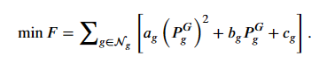
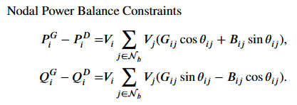
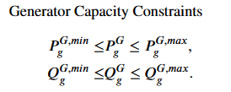
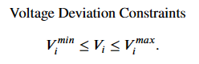
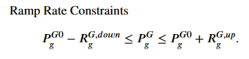
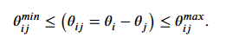
Methods

Slide 6
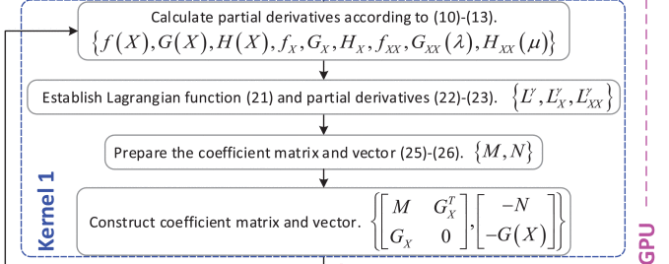
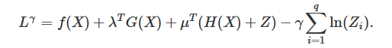
Methods
Kernal 1 Setup
Calculation of partial derivatives of the objective and constraints.
Lagrangians are computed and the matrix is generated
Additionally, as our matrices are stored in CSR format, matrix concatenation is a more complicated business

Slide 7

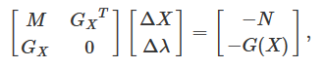
Methods
Kernal 2 Setup
This is the most compute intensive set as it involves matrix inversion (solving of a linear system of equations). This is accomplished using CuSolver
Solves for ΔX and Δλ

Slide 8
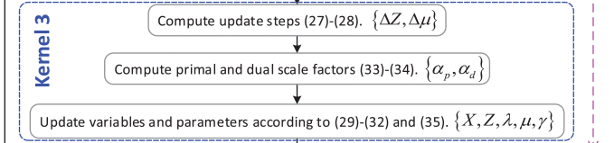
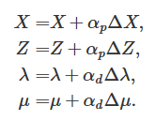
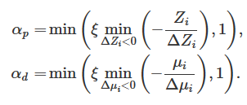
Methods
Kernal 3 Setup
The solved linear equation is used to compute and evaluate the update steps for the decision variables for the next iteration

Slide 9
Illustrative Example

Slide 10
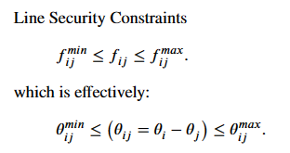
Illustrative Example

Slide 11
Progress and Current Results

Slide 12
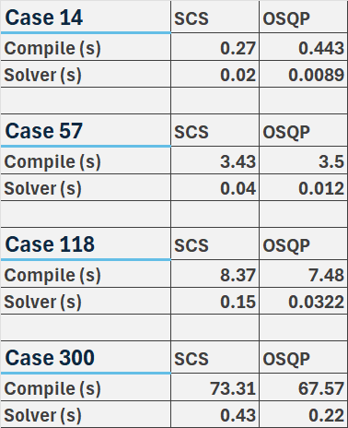
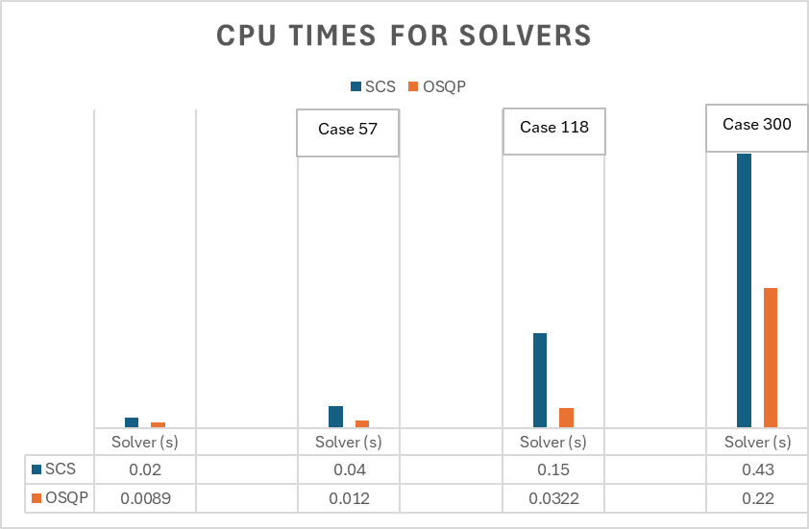
Progress and Current results
Solving for Cases 14, 57, 118, and 300
Utilized CVXPY, a Python-embedded modeling language for convex optimization problems
Compared performance using SCS and OSQP solvers
Compared Compile Time and Solver Time
Some constraints not implemented
Notes:
Mention

Slide 13
Way ahead

Slide 14
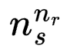
Way Ahead
Create C Kernels
Outlined in our Methods section
Must perform many matrix operations in parallel
Implement REG data and Create Scenarios
Scenario creation based on linear predictions of Solar or Wind input data
Solar radiation or wind speed
Translation of these predictions into power generation
Use prediction intervals to determine best scenarios to test
Note that the problem grows exponentially
N sub s is the number of scenarios per REG
N sub r is the number of REGs

